Slide 1
Targeted offers for marketing Analysis of different optimization algorithms
Team
Rajesh Sathya Kumar (rsathyak@asu.edu)
Chandrakant Vankayalapati (cvankaya@asu.edu)
Pramukh Belam (pbelam@asu.edu)

Slide 2
CONTENTS
Problem Description
Optimization Formulations
Experimental Parameters Generation
Experiments and Results
Conclusion
References

Slide 3
Motivating Question…
In the dynamic modern world, companies across all domains are adapting to serve and reach out to their customers in a much better way every single day. To carry out the activity, marketing campaigns are of paramount importance and millions, if not billions, of dollars are invested to effectuate a lucrative marketing campaign.
Considering a country like USA, which has a population of c.330 million, sending marketing emails/texts/pamphlet/etc. to everyone or a randomly chosen set of people would be a waste of time and money.
In this research piece we try to answer the question : ”Which products should be targeted to which customers to maximize profits, under the constraints that only a limited number can be targeted, and each product has a minimum sales target?”
We first formulate a naive objective function followed by set covering formulation. We then perform extensive computational experiments to choose the optimal model using integer programming.

Slide 4
Methodologies
Basic Formulation
Set-Covering Formulation:
Tactical Model Formulation
Operational Model Formulation

Slide 5

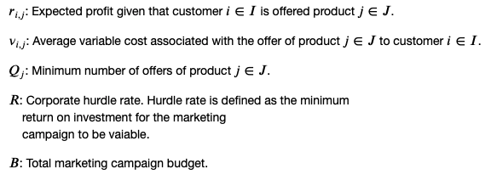

Basic Formulation:
Sets and Indices
Parameters
Decision Variables

Slide 6
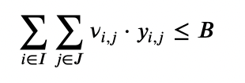
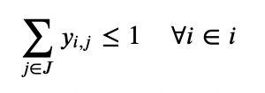
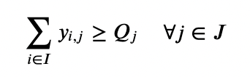
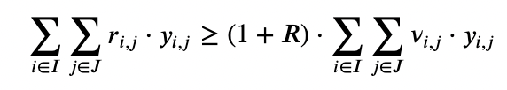
Basic Formulation: Constraints
Budget. The total marketing budget is limited by a fixed value 𝐵
Number of offers. Maximum number of products for each customer should be less than or equal to one (only one product can be offered to customer).
Offers limit. Minimum number of offers of each product.
ROI. The minimum ROI constraint ensures that the ratio of total profits over cost is at least one plus the corporate hurdle rate.
where, 𝑥𝑖,𝑗∈{0,1} This variable is equal to 1,
if product 𝑗∈𝐽 is offered to customer 𝑖∈𝐼, and 0 otherwise.

Slide 7
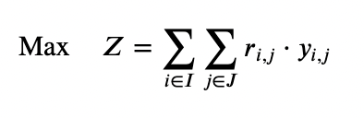
Basic/Naive Formulation: Objective Function
Total profit.
Maximize total expected profit from marketing campaign limited by the budget.

Slide 8
Why do we need a better method than the Naïve Model?
The ideal formulation is difficult to solve because of its scale. For 1 million customers and 10 products there are 10-million integer variables y_{ij}, this yields 2^{10,000,000} possible customer-offer combinations.
Using standard optimization methods, a problem of this size can, in principle, result in a branch and cut tree of as many nodes.
Thus, problems of this size are extremely difficult to solve, so we need a better solution than the naïve method. So, we use set-covering formulation method to approach this problem in a more efficient manner.

Slide 9
Set-Covering Formulation Approach
We divide the problem into two individual problems. a. Tactical Model Formulation
b. Operational Model Formulation
Tactical Formulation
Operational Model Formulation
We create clusters of customers based on individual expected profit parameters, which can be computed using predictive models. We use K-Means for clustering the customers.
Here, we determine the product offers for individual customers
By clustering, we can formulate the problem as a Linear Programming Problem by identifying the proportion within each cluster for each product that will maximize the return considering the constraints, instead of assigning offers to individual customers
We use estimated expected profits and output of tactical formulation as the inputs to operational formulation. We use this information to assign the products to individual customers within each cluster.

Slide 10


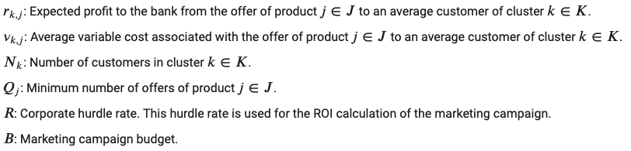
Tactical Formulation
Sets and Indices
Decision Variables
Parameters

Slide 11




Tactical Formulation: Constraints
Number of offers. Maximum number of offers of products for each cluster is limited by the number of customers in the cluster
Offers limit. Minimum number of offers of each product
Budget. The marketing campaign budget constraint enforces that the total cost of the campaign should be less than the budget campaign.
ROI. The minimum ROI constraint ensures that the ratio of total profits over cost is at least one plus the corporate hurdle rate.

Slide 12

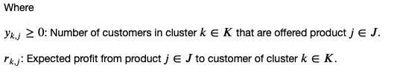
Tactical Formulation: Objective Function
Total profit.
Maximize total expected profit from marketing campaign which is constrained by the total budget.

Slide 13



Operational Model Formulation
Sets and Indices
Decision Variables
Parameters

Slide 14




Operational Model Formulation: Constraints
Product offers. Allocate offers of a product to customers of each cluster.
Binary constraints. Either a product offer is given to a customer of cluster k or not.
Offers limit. At most one product may be offered to a customer of a cluster.

Slide 15
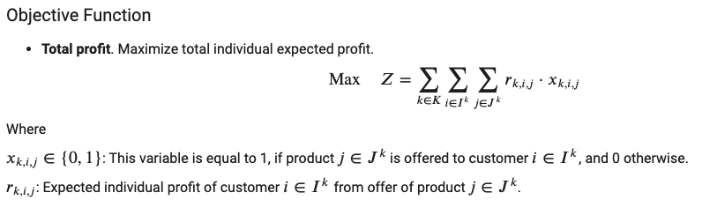
Operational Model Formulation: Objective Function
Total profit.

Slide 16
Experimental Parameter Generation
Budget. We set budgets as the average cost times the number of customers
Product Minimum Quantity. We generated this number as a random number such that the sum of all the products is at least 75% of the customers count
Cost per Product per Customer. Generated a random number from 80 to 450 with 40 spacing
Expected Profit per Product per Customer. Generated a random number from 1000 to 4000 with 200 spacing
Note: The cost and expected profit are not as per the experiments provided in the paper [1] but we made sure that the solution is feasible

Slide 17
Business Experiments: Description
An experiment was conducted to analyze the impact of budget on Return on Investment, Expected profits and Expected costs on the methodologies – Naïve Method and Set-Formulation Method.
The experiment was run while relaxing the “Return on Investment” constraint for the two methods. The experiment was conducted using the following set of parameters.
Parameters:
Number of customers: 10,000 Number of products offered: 15 Number of clusters: 10
The budget was varied between $80,000 and $2,941,698.

Slide 18
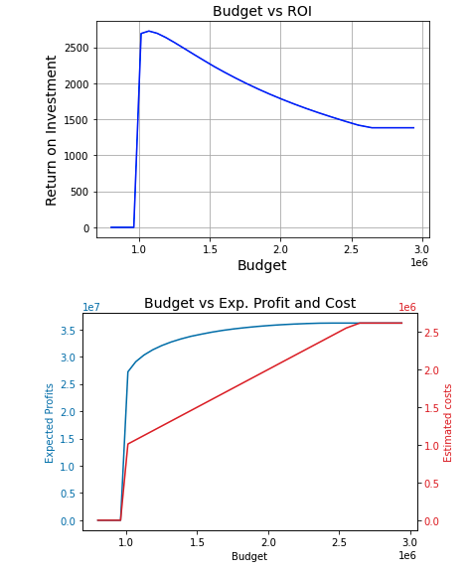
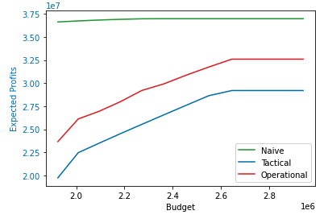
Business Experiments: Results
The results from the experiments are shown as below:
Fig 2: Expected profits estimated by the Naïve and Set-Formulation Models.
Fig 1: Campaign budget vs business metrics for the Naïve Model

Slide 19
Business Experiments: Observations and Conclusion
From Fig. 1, the expected ROI (100 * Total Expected Profit / Total Expected Loss) seems to increase steeply as we increase our campaign budget and then, decreases gradually. The initial ROI of 0 is when the the model is infeasible, and the allotted campaign budget is insufficient for the campaign.
The above observation shows us that after a particular budget, increase in the expected cost of campaign does not give a proportionate increase in profits.
The ROI flattens after a particular budget since only one product can be offered to each customer and once the product with most expected profit is offered given the constraints, we can no longer increase the profits. This is also evident from the expected profits and costs plot in Fig. 1.
Fig 2. shows us that the Naïve model gives us the best estimate of expected profits. This is expected since, we relax the binary constraint Y_{ij} in the set-covering formulation method. The Operational model gives us a better estimate since we are introducing the binary constraints again and the provided solution is closer to the optimal objective value given by the Naïve Model.

Slide 20
Computational Experiments: Description
We analyzed the algorithmic run times of the Basic Formulation and the Set-Covering Formulation with a given budget and varying the other parameters like Number of Customers, Number of Products and Corporate Rate
We also determine the Optimality Gap of the Basic formulation and the Set-Covering Formulation (with K-Means and Random Clustering)
The Experiments are run by varying with 3 product counts, 6 customer counts and 3 corporate rate. In total, we ran 3 * 6 * 3 = 54 computational experiments for basic formulation and varying only product and customer with 18 experiments with the set-covering formulation.
All other fixed constraints including budget are computed as per the paper [1] in such a way that the results are feasible and consistent with the real-time behavior.
Parameters
Number of Products = [ 5, 10, 15 ]
Number of Customers = [ 100, 200, 300, 1000, 2000, 10000 ]
Corporate rate = [ 0.05, 0.10, 0.15 ]

Slide 21
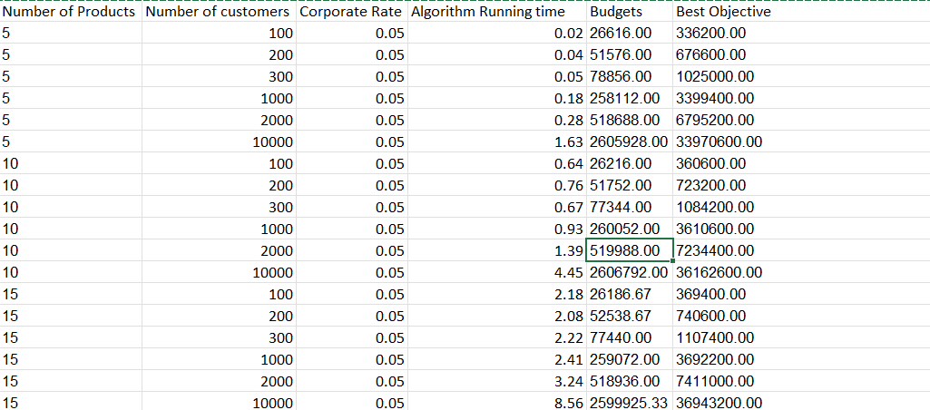
Computational Experiments: Results
Basic Formulation: Corporate Rate = 0.05

Slide 22
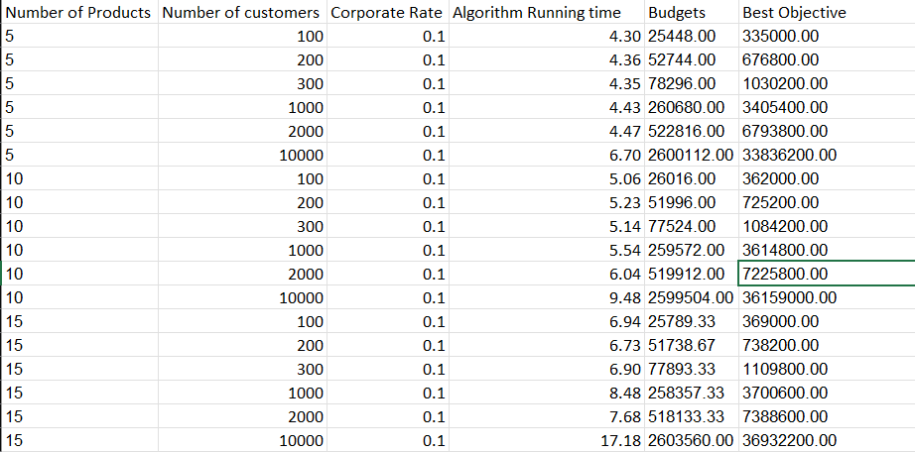
Computational Experiments: Results
Basic Formulation: Corporate Rate = 0.1

Slide 23
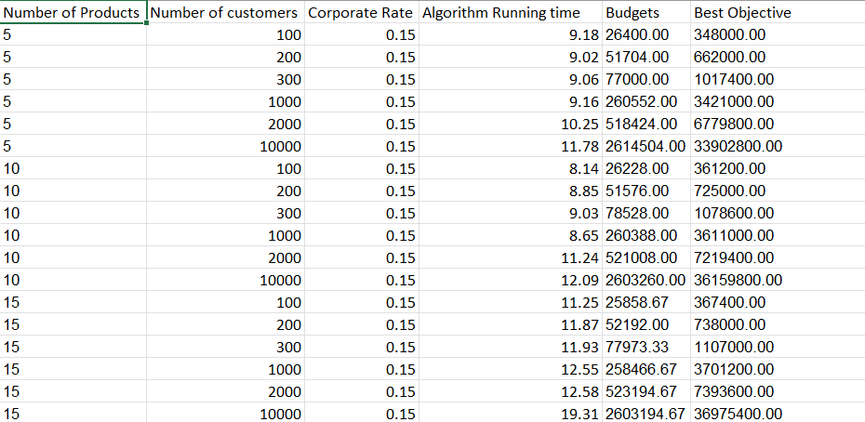
Computational Experiments: Results
Basic Formulation: Corporate Rate = 0.15

Slide 24
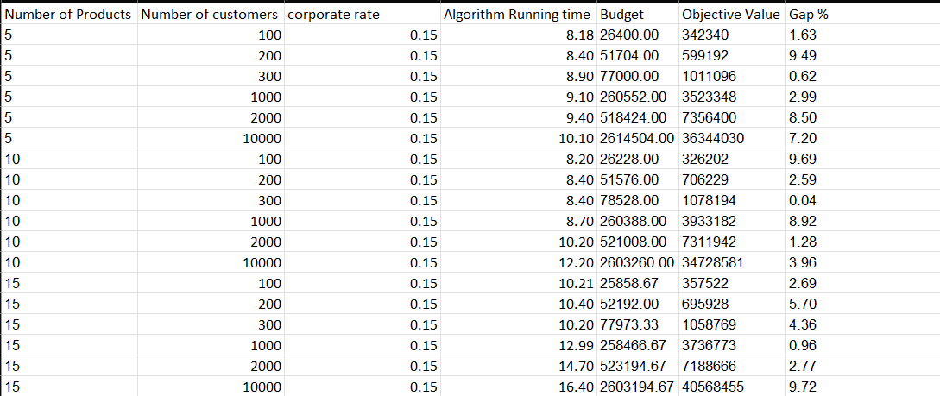
Computational Experiments: Results
Set-Covering Formulation with random clustering: Keeping Corporate Rate constant at 0.15

Slide 25
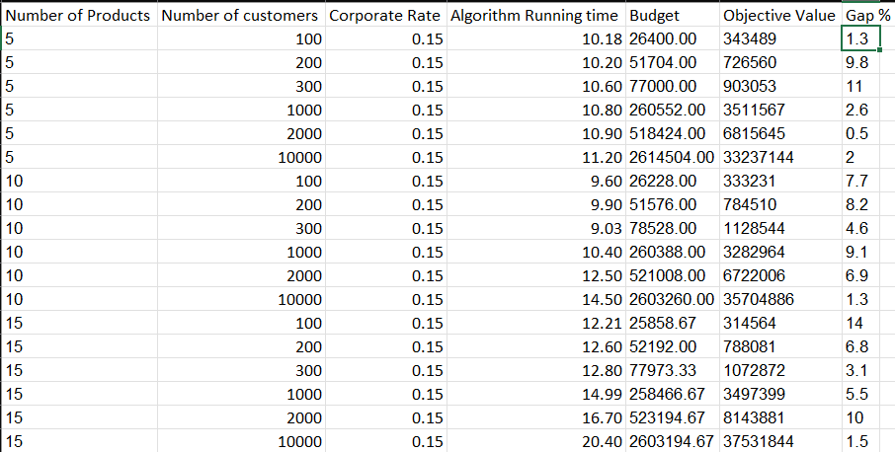
Computational Experiments: Results
Set-Covering Formulation with K-means clustering: Keeping Corporate Rate constant at 0.15

Slide 26
Computational Experiments: Observation and Conclusion
Based on the Basic Formulation Results, we can conclude that the running time increases as we increase any of the parameters such as Number of products, Number of Customers and Corporate Rate.
There is also a proof in the paper[1] that shows that the Basic Formulation is an NP-Hard Problem
The Basic formulation gave us exact solutions and hence, there was no optimality gap
We observed that in the set-covering formulations, there was some optimality gap, which increases as we increased each of the parameters
We also observe that the Set-covering algorithm with K-Means takes longer time than the one with random clustering

Slide 27
Problem Extension Experiment: Budget Correction
The marketing campaign problem that we formulated is a generic version and companies can add extensions, change the constraints or change objective functions tailored to their business requirements.
We explored one such extension to experiment with the optimization model. We used a hard constraint to limit the budget for the campaign and this gave us infeasible solution for low budgets.
In order to mitigate this problem, we introduced a new variable “z” which acts as a budget correction variable. However, we penalize the budget correction heavily with a Scalar “M”.

Slide 28
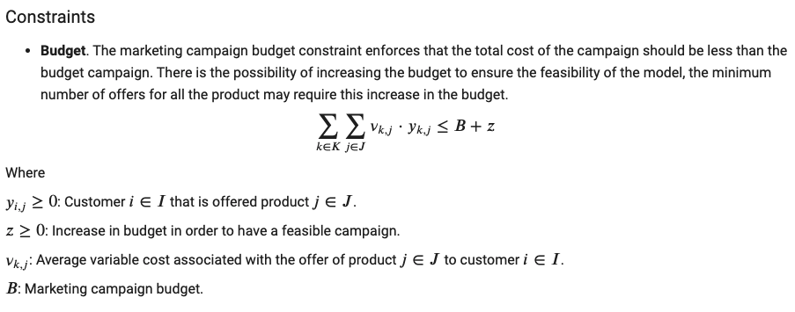
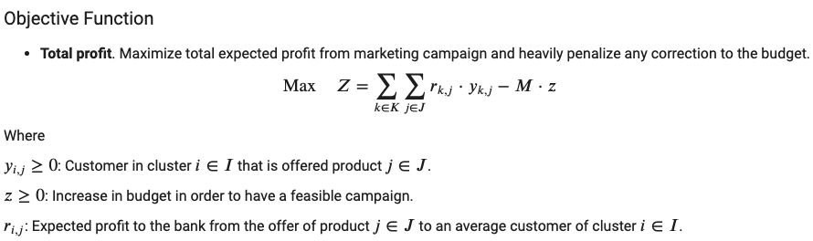
Budget Correction: Formulation Changes
The changes in the problem formulation for the naïve model is shown below.

Slide 29
Budget Correction: Results
We run an experiment with 100 customers, 5 products and an insufficient budget of $8000 on the naïve model with budget correction.
We provide a heavy penalty of 10000 to the budget correction factor M.
The expected profit after the correction is $252,400.00.
Optimal total expected cost is $12,800.00 with a budget of $8,000.00 and an extra amount of $4,800.00.
Optimal ROI is 1971.88% with a minimum ROI of 110.0%.
Thus, this extension can be used when the budget is insufficient.

Slide 30
Conclusion
In this project, we explored the various optimization problem formulations for providing targeted offers in marketing
We experimented with a Basic Formulation and a Set Covering Formulation
From the business experiments, we can conclude that the business stake holders should investigate the insights from the models and take a decision from the data. For example, we can see that ROI decreases while Profits increase as the campaign budget increases. The business should decide if they need to prioritize profits or the ROI.
We concluded that the Basic formulation from our experiments but provided exact solutions for the LP problem
Then, We solved with a Set-Covering Formulation by random clustering and K-Means clustering
We saw that random clustering performed better in terms of running time that with K-means Clustering
Both the methods had some optimality gap, that increased as we increased the data

Slide 31
References
Optimization models for targeted offers in direct marketing: exact and heuristic algorithms. https://feb.kuleuven.be/public/u0004371/published%20papers/promotion.pdf
Exploiting response models: optimizing cross-sell and up-sell opportunities in banking. https://citeseerx.ist.psu.edu/viewdoc/download?doi=10.1.1.12.7598&rep=rep1&type=pdf

Slide 32
Thank You

